Slide 1
Muralikrishnan Subbaian
Data Modelling in Hadoop
BAS Academy

Slide 2
AGENDA
Overview
Data Storage Formats
Compression Techniques
Schema Design
Conclusion

Slide 3
Overview
At its core, Hadoop is a distributed data store that provides a platform for implementing powerful parallel processing frameworks. The reliability of this data store when it comes to storing massive volumes of data, coupled with its flexibility in running multiple processing frameworks makes it an ideal choice for your data hub. This characteristic of Hadoop means that you can store any type of data as is, without placing any constraints on how that data is processed.
Although Hadoop has a powerful feature of storing raw data, before dumping the data to the Hadoop Distributed File System, we should consider what data storage format, compression techniques, schema design (which includes the directory structure to load data to HDFS, row key design, partitioning, bucketing) should be used, in order to access and process huge volume of data more efficiently

Slide 4
Data Storage Format
Parquet File:
It is a columnar file storage.
Basically this means that instead of just storing rows of data adjacent to one another you also store column values adjacent to each other. This is particularly useful if your data processing framework just needs access to a subset of data that is stored on disk as it can access all values of a single column very quickly without reading whole records.
One huge benefit of columnar oriented file formats is that data in the same column tends to be compressed together which can yield some massive storage optimizations (as data in the same column tends to be similar).

Slide 5
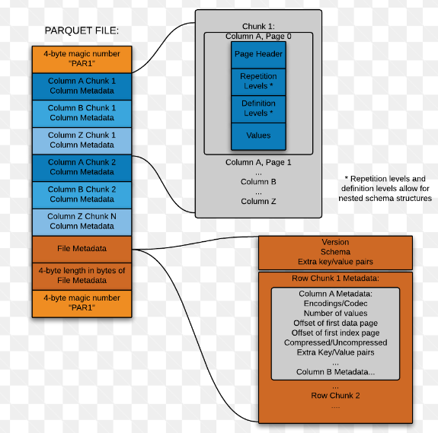
Data Storage Format

Slide 6
Data Storage Format
Language Neutral Data Serialization system
- Write a file in python and read it in C
Avro data is described using language independent scema
Avro schemas are usually written in JSON and data is encoded in binary format
Supports schema evolution
- producers and consumers at different versions of schema
Supports compression and are splittable
Avro File:

Slide 7
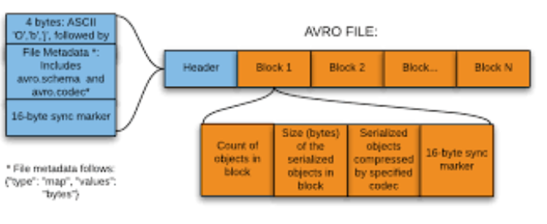
Data Storage Format

Slide 8
Data Storage Format
ORC File:
The Optimized Row Columnar (ORC) file format provides a highly efficient way to store Hive data.
Using ORC files improves performance when Hive is reading, writing, and processing data.
An ORC file contains groups of row data called stripes, along with auxiliary information in a file footer. At the end of the file a postscript holds compression parameters and the size of the compressed footer.
The default stripe size is 250 MB. Large stripe sizes enable large, efficient reads from HDFS.
The file footer contains a list of stripes in the file, the number of rows per stripe, and each column's data type. It also contains column-level aggregates count, min, max, and sum.

Slide 9
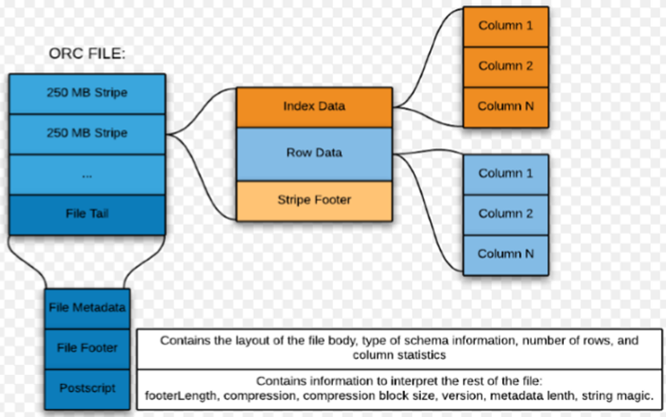
Data Storage Format

Slide 10
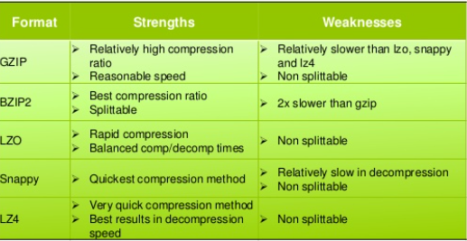
Compression
In general, any compression format can be made splittable when used with container file formats (Avro, SequenceFiles, etc.) that compress blocks of records or each record individually. If you are doing compression on the entire file without using a container file format, then you have to use a compression format that inherently supports splitting (e.g., bzip2, which inserts synchronization markers between blocks).

Slide 11
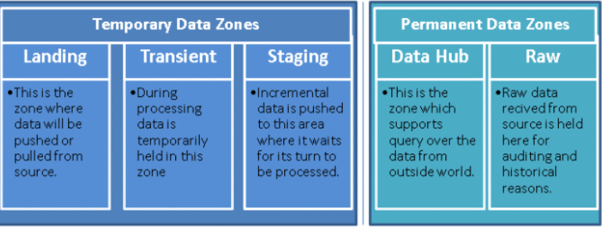
HDFS Schema Design
A standard directory structure makes it easier to share data between teams working with the same data sets.It also allows for enforcing access and quota controls to prevent accidental deletion or corruption.Oftentimes, you’d “stage” data in a separate location before all of it was ready to be processed. Conventions regarding staging data will help ensure that partially loaded data will not get accidentally processed as if it were complete.

Slide 12
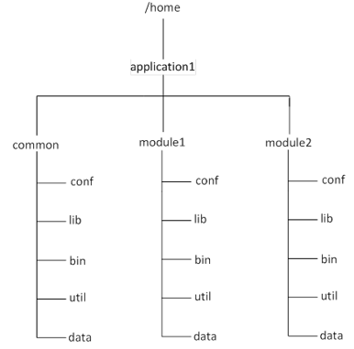
HDFS Schema Design

Slide 13
Conclusion
Although data modelling in any system is a challenging task, it’s especially challenging in the Hadoop ecosystem due to the vast expanse of options available. A number of file formats exist for storing data, with Avro being a very popular choice for row-oriented formats, and ORC and Parquet being a popular choice for column-oriented ones. A good choice of compression codecs to use for HDFS data exists as well, Snappy being one of the more popular ones. Choosing the right model for our data is one of the most important decisions we have to make in our application

